Slide 1
Build CPU in 1 Month
Lecture 01

Slide 2
To-Do Lists
Intro
Grammar(Verilog and SystemVerilog)
Architecture
Toolchain
Hand on
Why our simulation don’t pass?
Add instruction
Run monitor program
Course assignment
Advice for report

Slide 3
Grammar(Verilog and SystemVerilog)
adder.v
wire reg
always @(*)
always @(posedge clk)
adder.sv
logic
always_comb
always_ff @(posedge clk)
support other data types, enum …
especially for verification
SystemVerilog 是从 Verilog 扩展而来，也支持 Verilog 的一些语法，都属于经典的 HDL(Hardware Description Language)

Slide 4
Grammar(Verilog and SystemVerilog)
declare variable（声明变量）
logic [31 : 0] a, b, c; logic [31 : 0] mem [1023 : 0];
process block（过程块）
combinational logic
always_comb begin
c = a + b;
end
sequential logic
always_ff @(posedge clk) begin
c <= a + b;
end

Slide 5
Grammar(Verilog and SystemVerilog)
declare variable（声明变量）
logic [31 : 0] a, b, c; logic [31 : 0] mem [1023 : 0];
process block（过程块）
combinational logic
always_comb begin
c = a + b;
end
sequential logic
always_ff @(posedge clk) begin
c <= a + b;
end

Slide 6
Grammar(Verilog and SystemVerilog)
sel_a
ternary expression（三元表达式）
logic a, b, c, sel_a;
always_comb begin
c = sel_a ? a : b;
end
if else
always_comb begin
if (sel_a) c = a;
else c = b;
end
a
MUX
c
b
case
always_comb begin
case (sel_a)
1'b1 : c = a;
1'b0 : c = b;
default : c = a;
endcase
end
sel_a
a
MUX
a
LOOP!!!
b

Slide 7
Grammar(Verilog and SystemVerilog)
sel_a
ternary expression（三元表达式）
logic a, b, c, sel_a;
always_comb begin
c = sel_a ? a : b;
end
if else
always_comb begin
if (sel_a) c = a;
else c = b;
end
a
MUX
c
b
case
always_comb begin
case (sel_a)
1'b1 : c = a;
1'b0 : c = b;
default : c = a;
endcase
end
sel_a
a
MUX
a
LOOP!!!
b

Slide 8
Grammar(Verilog and SystemVerilog)
sel_a
ternary expression（三元表达式）
logic a, b, c, sel_a;
always_comb begin
c = sel_a ? a : b;
end
if else
always_comb begin
if (sel_a) c = a;
else c = b;
end
a
MUX
c
b
case
always_comb begin
case (sel_a)
1'b1 : c = a;
1'b0 : c = b;
default : c = a;
endcase
end
sel_a
a
MUX
a
LOOP!!!
b

Slide 9
To-Do Lists
Intro
Grammar(Verilog and SystemVerilog)
Architecture
Toolchain
Hand on
Why our simulation don’t pass?
Add instruction
Run monitor program
Course assignment
Advice for report

Slide 10
Architecture
5-stage pipeline CPU
classical micro-architecture and memory connected with bus
PC
ifid
idexe
STALL
exemen
memwb
REG
FILE
IF
EXE
MEM
WB
ID
BUS
Kernel
code
Kernel
data
User
code
User
data
Serial
port

Slide 11
Architecture
Bus（总线）
定义：一组物理线和连接器的集合，计算机组件间交换数据常用的一种标准规范，处理器、内存、I/O传递信息的公用通道。总之，主机各部件通过总线连接，外设通过相应接口电路与总线连接
基本功能：在多个设备间搭建一条数据通路，响应每个设备的请求
Kernel code
inst REQ
Kernel data
Core
Bus
Arbiter
Address Decode
User code
data REQ
User data
Serial port

Slide 12
To-Do Lists
Intro
Grammar(Verilog and SystemVerilog)
Architecture
Toolchain
Hand on
Why our simulation don’t pass?
Add instruction
Run monitor program
Course assignment
Advice for report

Slide 13
Toolchain
Vivado 2019.2
General develop flow: Simulate HDL files, Synthesis, Implementation, Generate bitstream
DVT Eclipse
get rid of Vivado useless integrated editor
VS Code
a not bad choice to replace DVT but it takes some time to configure

Slide 14
Toolchain
This page tells you some unnecessary auxiliary tools
MARS(MIPS Assembly Runtime Simulator)
run the code in single step
view all the registers’ value in GUI
QEMU(Quick EMUlator)
run your own program in this fast, open source emulator
use this tool through command line
MTI Bare Metal Toolchain --- compile the assembly code

Slide 15
To-Do Lists
Intro
Grammar(Verilog and SystemVerilog)
Architecture
Toolchain
Hand on
Why our simulation don’t pass?
Add instruction
Run monitor program
Course assignment
Advice for report

Slide 16
Comparison Mechanism（比对机制）
Q:
How to confirm that CPU runs correctly?
A:
The aim of program is always to change the value of register(or memory).
Compare our CPU executing results with the GS132(reference).
Core
REG
FILE
=
Ref.
PASS/FAIL

Slide 17
Comparison Mechanism（比对机制）
Q:
How to confirm that CPU runs correctly?
A:
The aim of program is always to change the value of register(or memory).
Compare our CPU executing results with the GS132(reference).
Core
REG
FILE
=
Ref.
PASS/FAIL

Slide 18
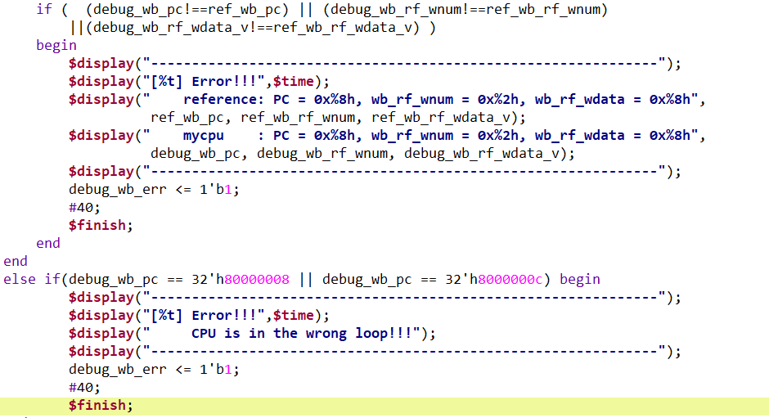
Comparison Mechanism（比对机制）
If our CPU’s information is different from the reference, or when the CPU runs in a wrong loop, the simulation will stop

Slide 19
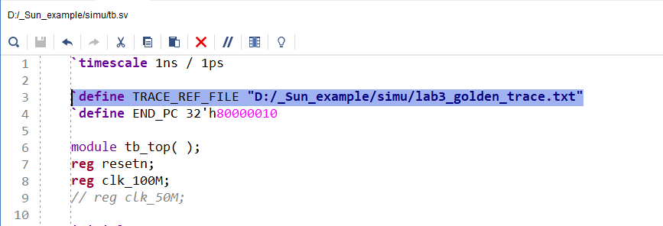
Run Behavioral Simulation
Change the path of trace file in testbench

Slide 20
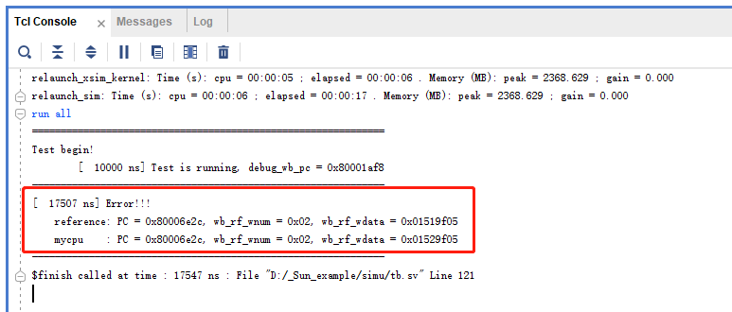
Filed To Run The Program
Change the path of trace file in testbench
Now begin debugging happily :)

Slide 21
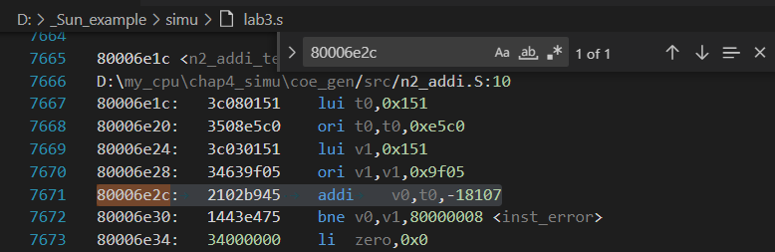
Why Our Simulation Don’t Pass?
Step 1: Check the lab3.s
a file translate .bin to assembly code with other information（反汇编）
an important file to find the bug!
Step 2: Find the instruction according to PC
GET IT! ADDI

Slide 22
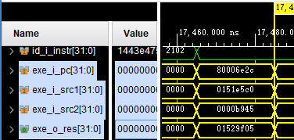
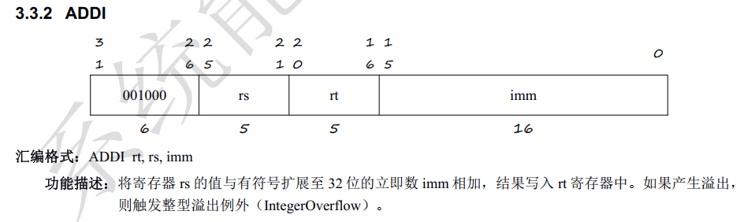
Why Our Simulation Don’t Pass?
Step 3: Check the instruction set definition
Find the operands in Vivado wave window
0151e5c0
+
0000b945
=
01529f05

Slide 23
Why Our Simulation Don’t Pass?
Step 3: Check the instruction set definition
Find the operands in Vivado wave window
0151e5c0
+
0000b945
=
01529f05
1011_1001_0100_0101(H) = -18107(D)

Slide 24
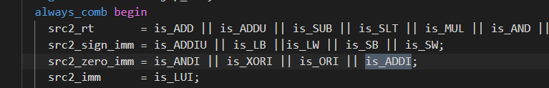
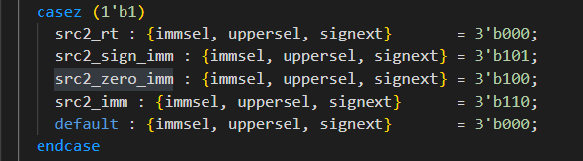
Why Our Simulation Don’t Pass?
Step 4: Edit code
Where the exe_i_src2 is assigned?

Slide 25
Run Simulation Again
What is result? :)

Slide 26
To-Do Lists
Intro
Grammar(Verilog and SystemVerilog)
Architecture
Toolchain
Hand on
Why our simulation don’t pass?
Add instruction
Run monitor program
Course assignment
How to accomplish it

Slide 27
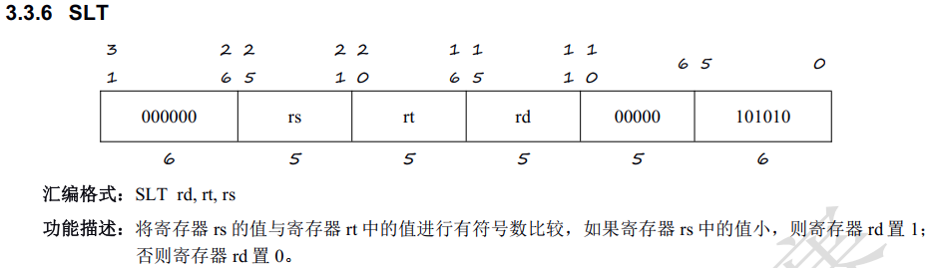
Add Instruction
Consider SLT
Read the definition of this inst.

Slide 28
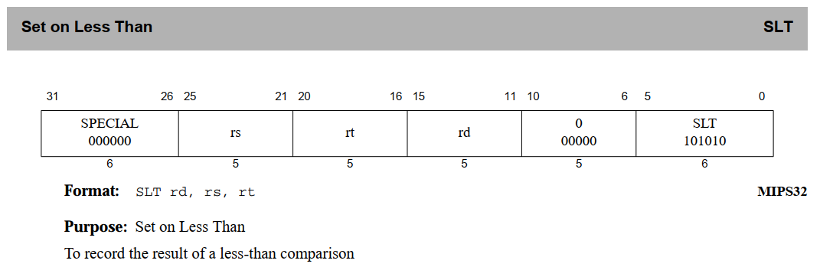
Add Instruction
Consider SLT
Read the definition of this inst.

Slide 29
Add Instruction
Step 1: Decide the type of the inst.
Step 2: Decide the regfile read address
Step 3: Decide the data format of source operand
src1 is always $Rs, and needn’t change format
src2 is from $Rt or immediate(original / 0 extend / signed extend)
Step 4: Decide alutype
Step 5: Decide aluop
…

Slide 30
After Modification
We have corrected ADDI and implemented SLT, it’s fantastic!
So what about accomplish a CPU in 1 month?
Run simulation again, see the result
does the CPU pass the test?
Oooo god! There’s something wrong…

Slide 31
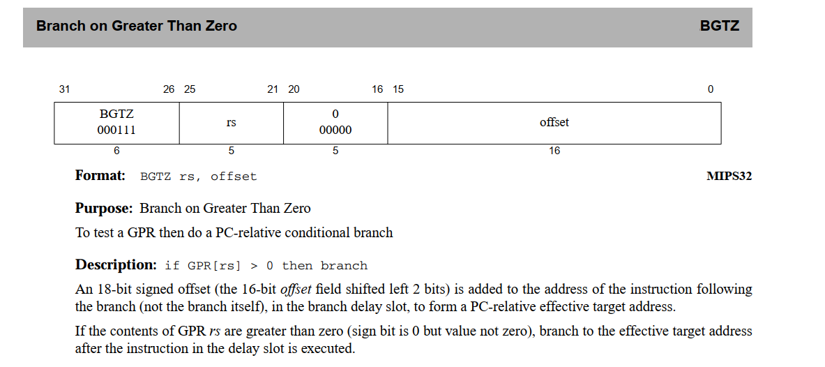
Boss In Lecture 01 --- BGTZ

Slide 32
To-Do Lists
Intro
Grammar(Verilog and SystemVerilog)
Architecture
Toolchain
Hand on
Why our simulation don’t pass?
Add instruction
Run monitor program
Course assignment
How to accomplish it

Slide 33
Run Monitor Program
Kernel
Term
Serial
BUS
Kernel Code
Kernel Data
User
Code
User
Data
监控程序的介绍及命令使用参考官方文档
监控程序的实现原理

Slide 34
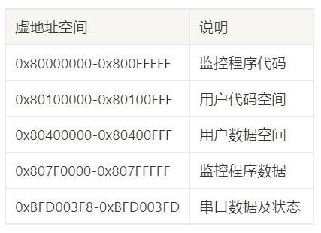
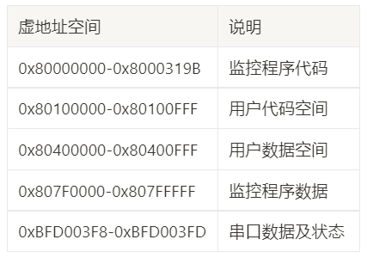
Run Monitor Program
To run the program, load all the memory in FPGA

Slide 35
To-Do Lists
Intro
Grammar(Verilog and SystemVerilog)
Architecture
Toolchain
Hand on
Why our simulation don’t pass?
Add instruction
Run monitor program
Course assignment
Advice for report

Slide 36
Advice For Report
处理器研究的重要性
芯片的研究意义
国内外研究现状
通用处理器（RISC-V、香山、“一生一芯”、BOOM、玄铁…）
图形处理器（GPU）
AI 处理器（寒武纪、晟腾…）
调研资料
龙芯杯 wiki，往届优秀作品
书籍
《自己动手写 CPU》《计算机系统设计：基于FPGA的RISC处理器设计与实践》
《计算机体系结构：量化研究方法》《计算机组成与设计：硬件/软件接口》
《超标量处理设计》…

Slide 37
End & CU~
Lecture 01

